Slide 1
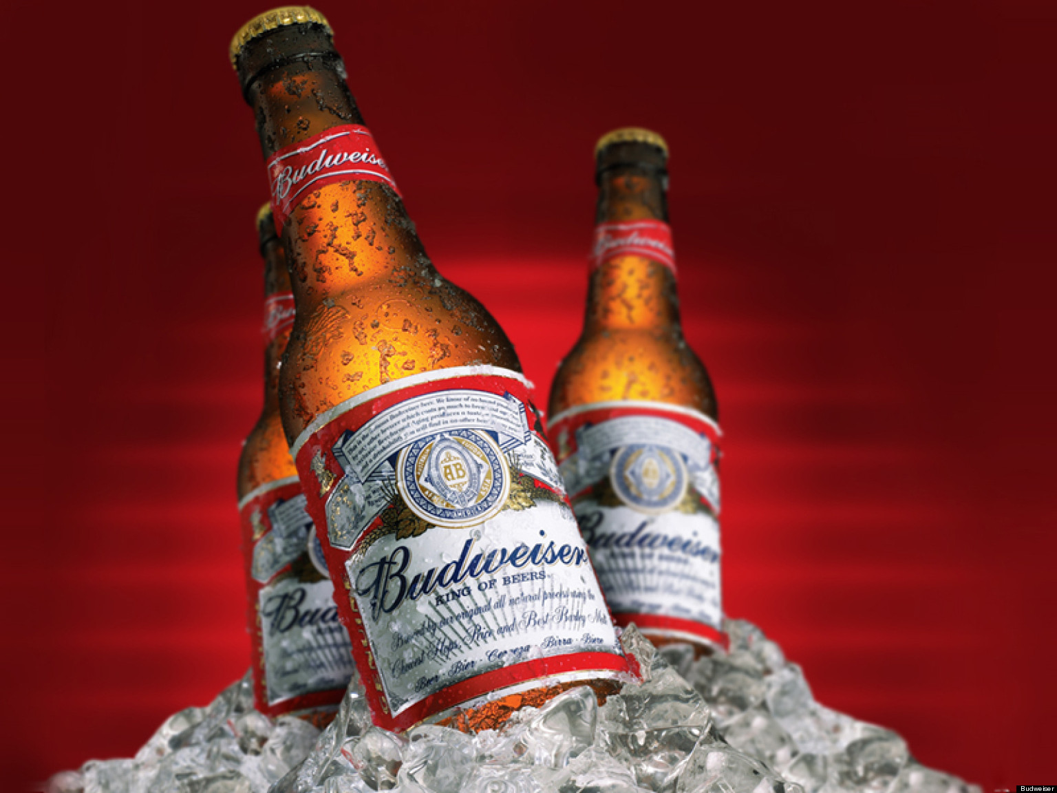
Case Study 01
Josh Mitchell
&
Erin McClure-Price

Slide 2
General Overview
Colorado has more breweries than any other state (47)
A simply scatterplot of IBU vs ABV showed positive correlation, inferring that alcohol increases as bitterness increases (or vice versa)
IPA style beers were higher in both IBU and ABV (THIS IS A GUESS)
Median IBU content were significantly lower in a handful of states
ABV content did not vary greatly, with exceptions occurring for significantly lower ABV content in both Arkansas and Utah

Slide 3
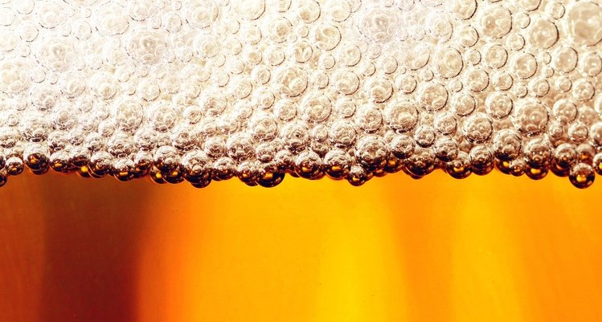
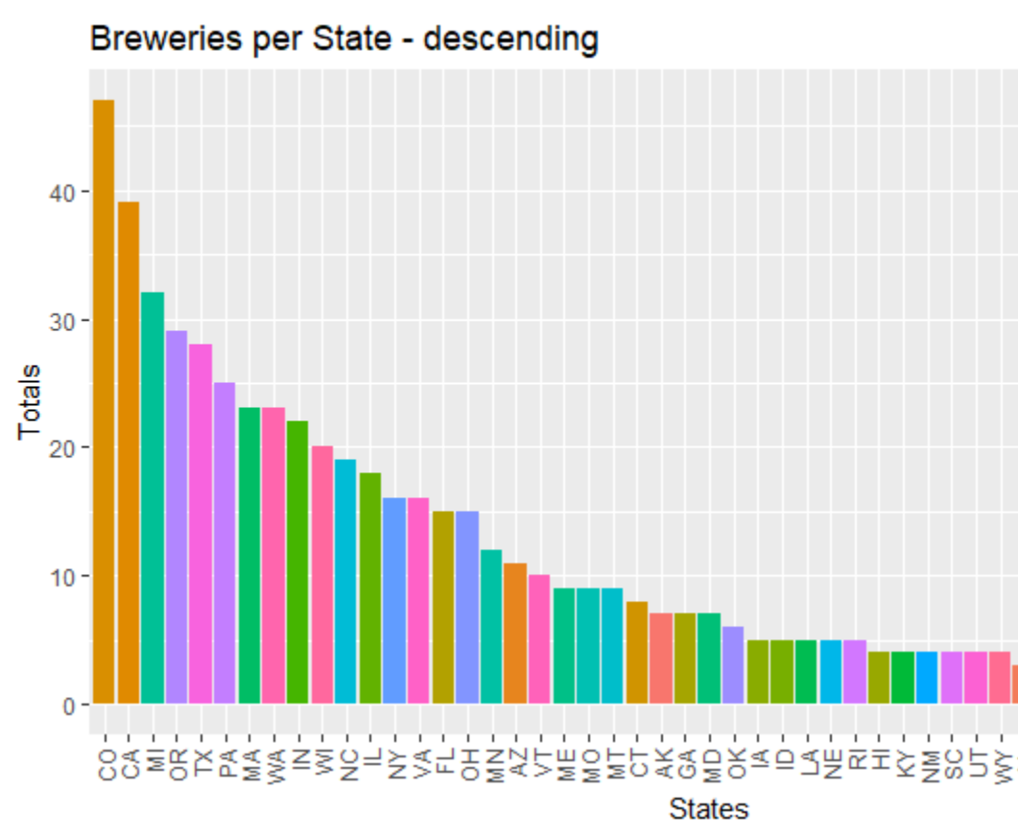
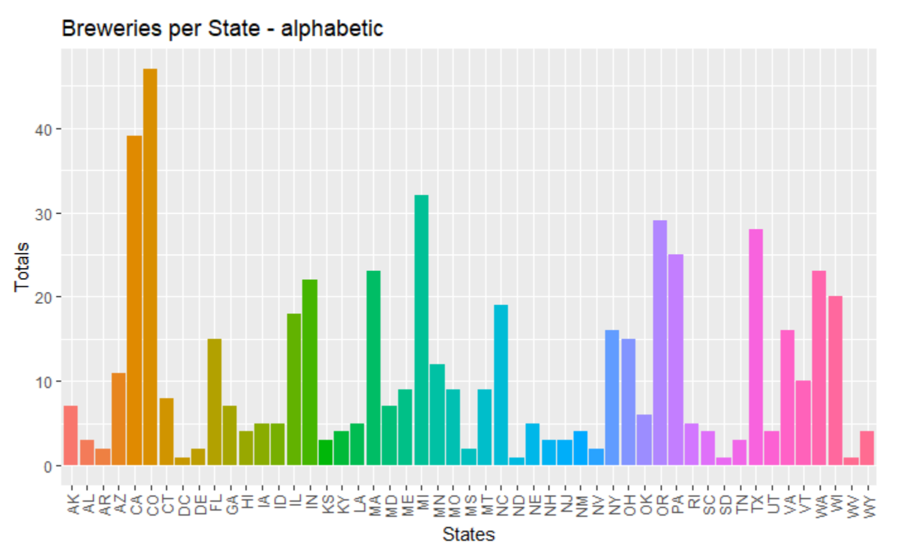
Breweries per State
Brief analysis
Min : 1.00
Max : 47.00
Mean : 10.94
SD : 10.61
Notes:
1. How many breweries are present in each state? -Erin

Slide 4
Addressing Missing Data
Total Missing Data Points: 2,410
Total of Missing Data for IBU: 959
Total of Missing Data for ABV: 1
Minimize impact on calculations
Approximately 40% of data has some form of missing entries
Replace missing values with ‘0’
Notes:
3. Address the missing values in each column. -Josh

Slide 5
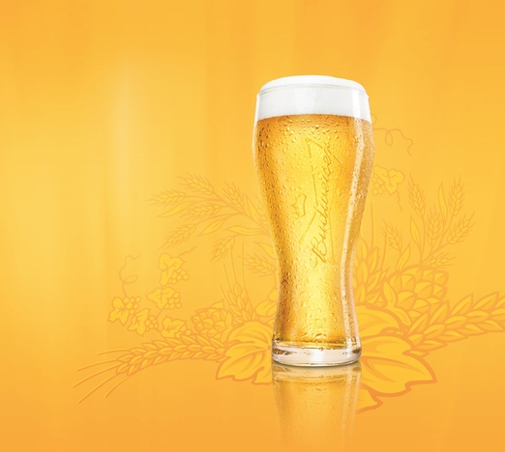
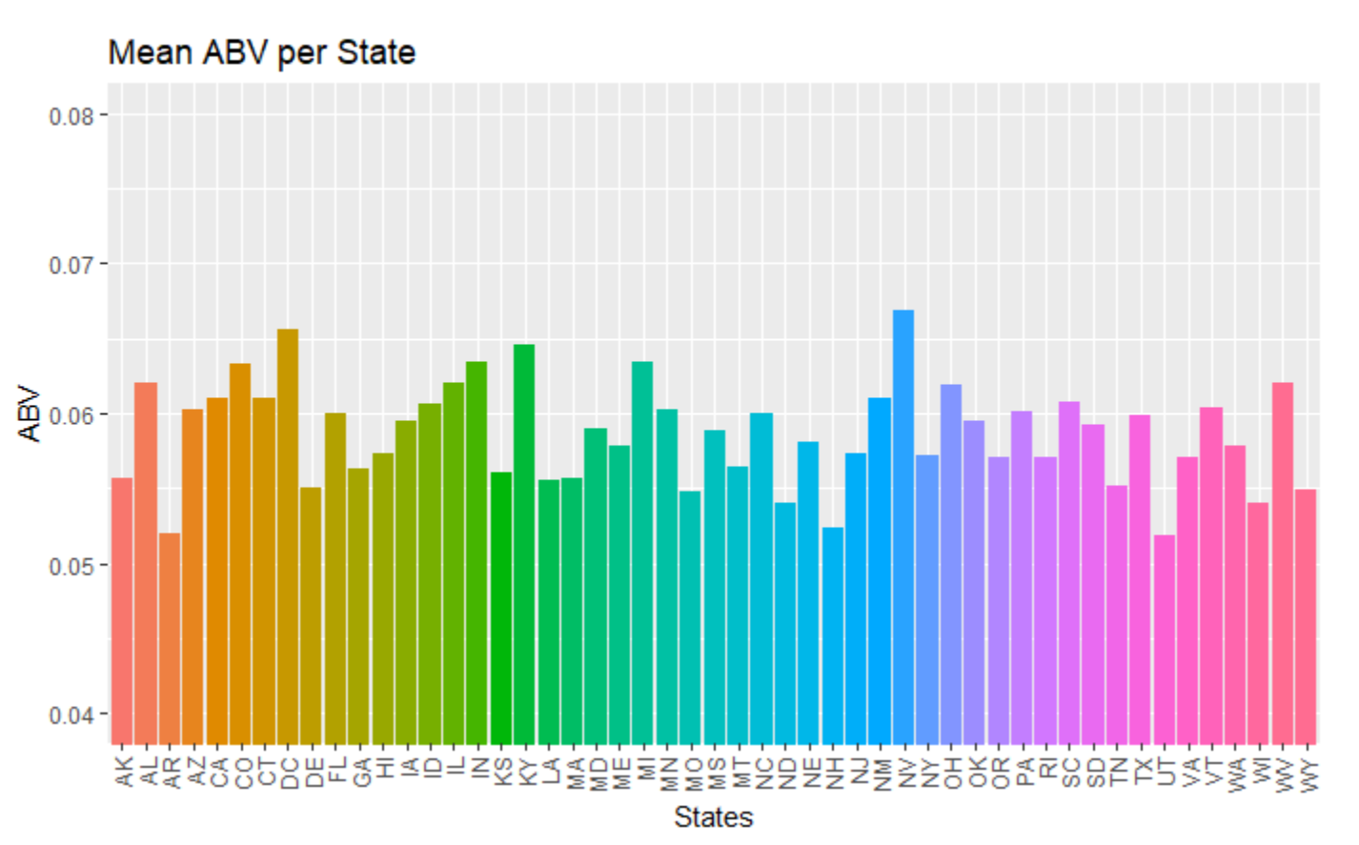
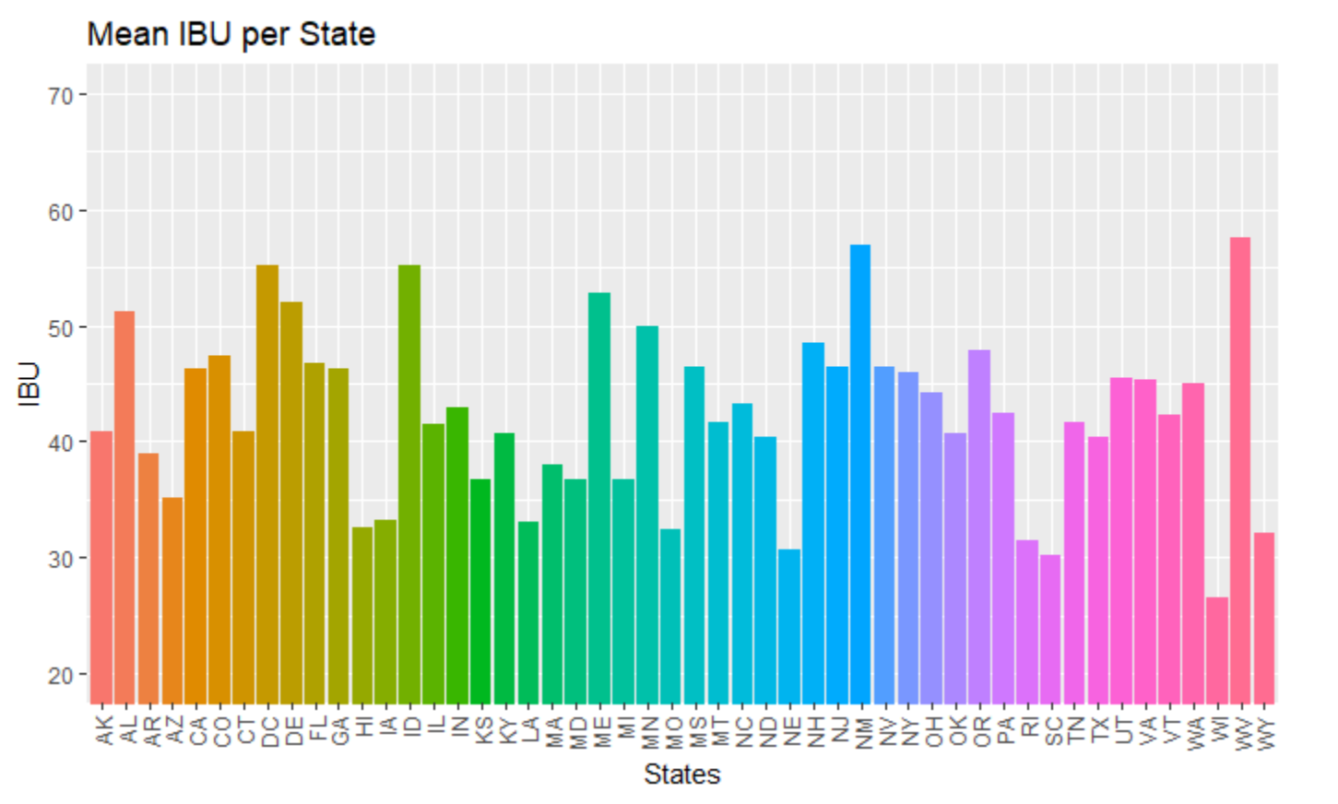
Median Abu & IBU
Insufficient data available for South Dakota
Highest IBU: Oregon
Highest ABV: Colorado
Notes:
4. Compute the median alcohol content and international bitterness unit for each state. Plot a bar chart to compare. -Erin
5. Which state has the maximum alcoholic (ABV) beer? Which state has the most bitter (IBU) beer? -Erin

Slide 6
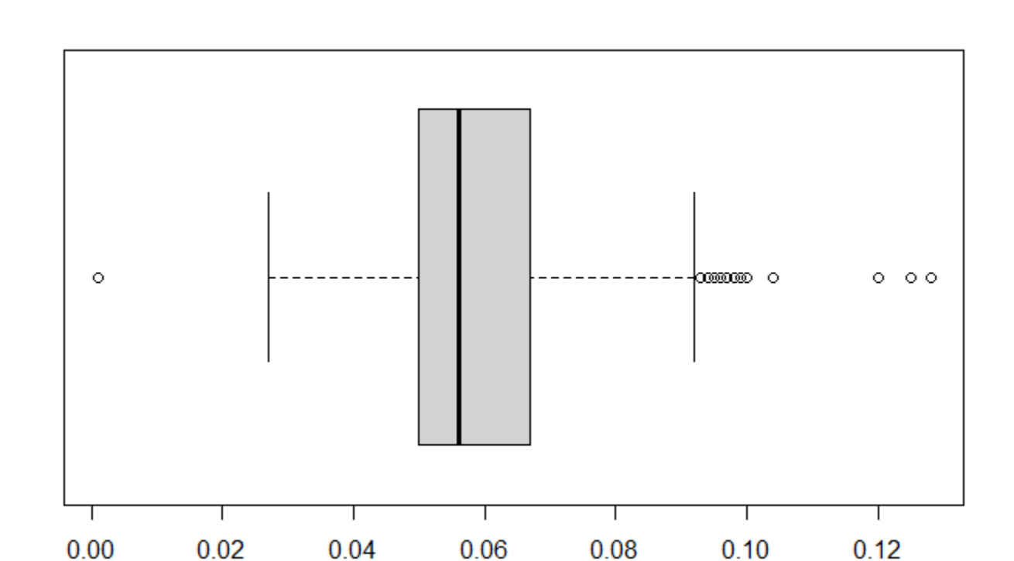
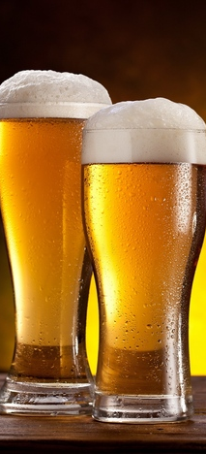
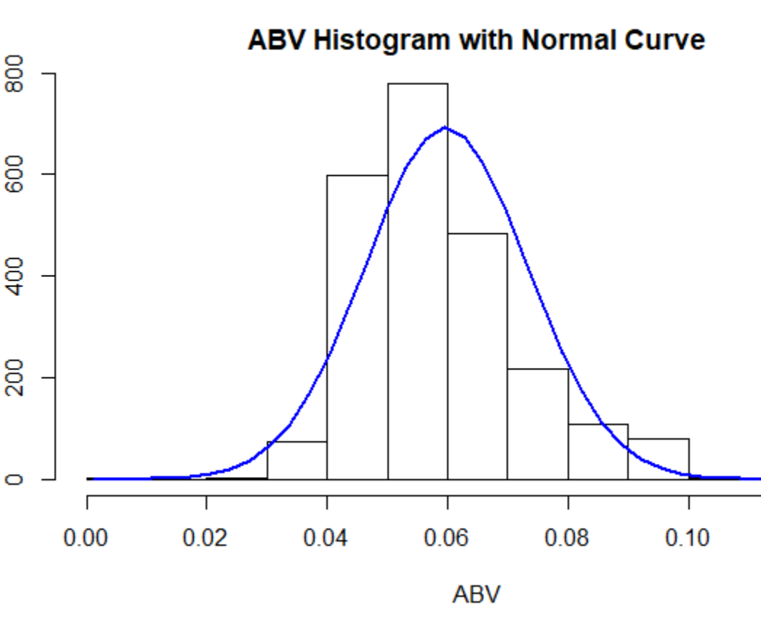
ABV Summary
Min. : 0.00100
Mean : 0.05977
Max : 0.12800
Standard Dev. : 0.01354173
Variance : 0.0001833786
Notes:
6. Comment on the summary statistics and distribution of the ABV variable. -Josh

Slide 7
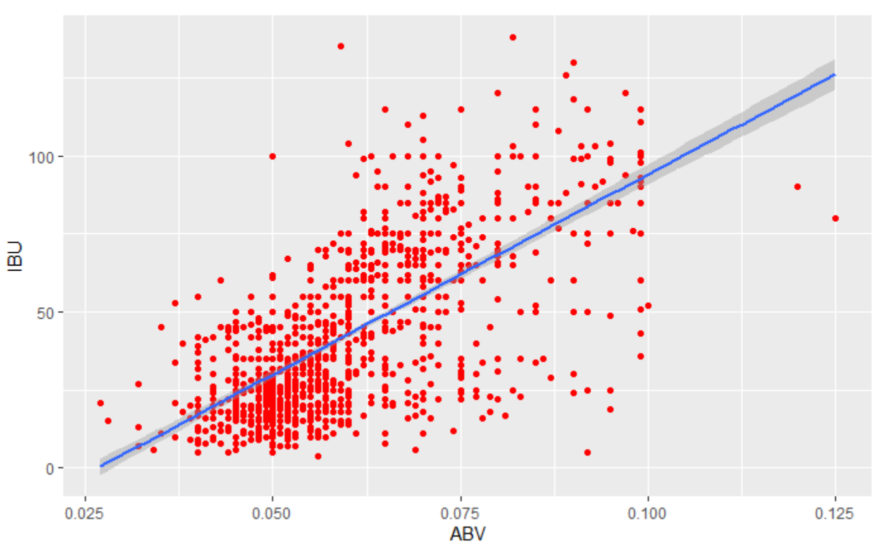
ABV & IBU Relationship
Min : 0.00100
Mean : 0.05977
Max : 0.12800
Standard Deviation : 0.01354173
Variance : 0.0001833786
Notes:
7. Is there an apparent relationship between the bitterness of the beer and its alcoholic content? Draw a scatter plot. Make your best judgment of a relationship and EXPLAIN your answer. -Erin

Slide 8
Notes:
6. Comment on the summary statistics and distribution of the ABV variable. -Josh

Slide 9
Notes:
7. Is there an apparent relationship between the bitterness of the beer and its alcoholic content? Draw a scatter plot. Make your best judgment of a relationship and EXPLAIN your answer.

